Slide 1

Fall Detection System
TARP Project

Slide 2


Meet The Team
Navaneeth Amarnath
20BRS1195
Lakshmi Rajeev
20BAI1294
Renil Augustine Baby
20BCE1826
Aayush Krishna
20BPS1102

Slide 3
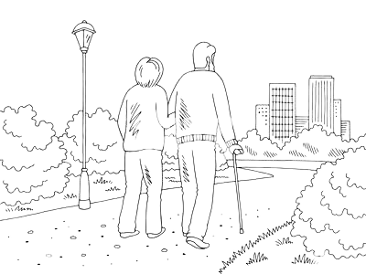
Abstract
The number of persons above the age of 60 years is fast growing , especially in India. India as the second most populous country in the world has 104 million people at or over the age of 60, constituting above 7.53% of the population as per the recent statistics. The major area of concern is health of the elderly with multiple medial and psychological problems. Falls are one of the major problems in the elderly. Recurrent Falls are an important cause of morbidity and mortality in the elderly and are a marker of poor physical and cognitive status. Our product focuses on this problem.

Slide 4

Statisctics

Slide 5
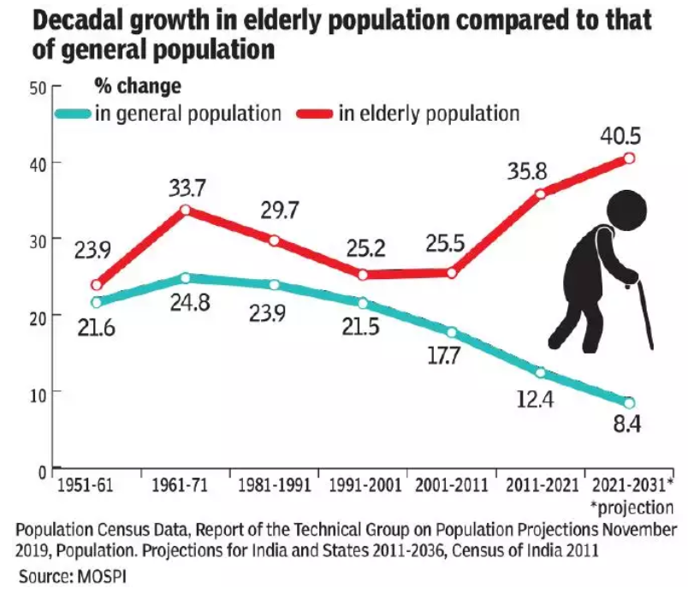
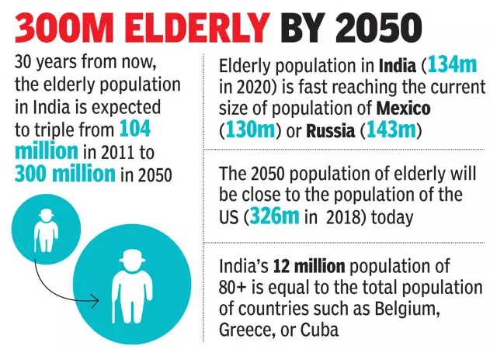

Slide 6
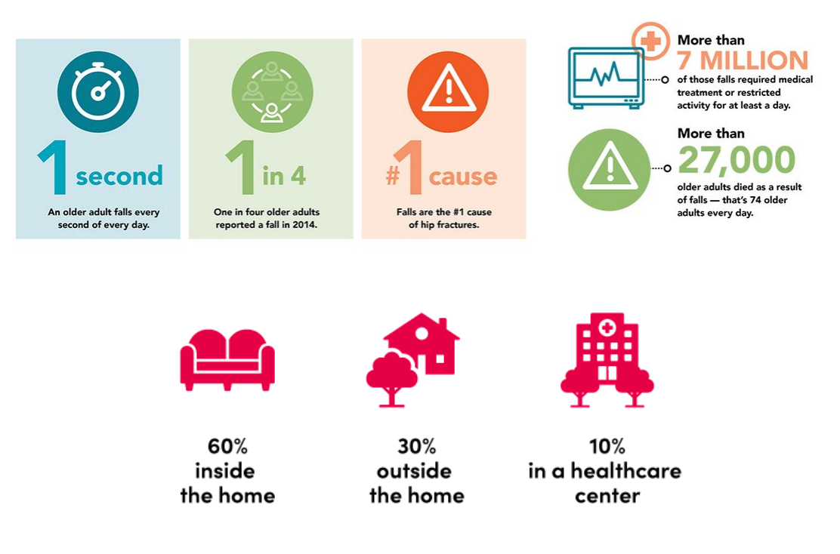

Slide 7
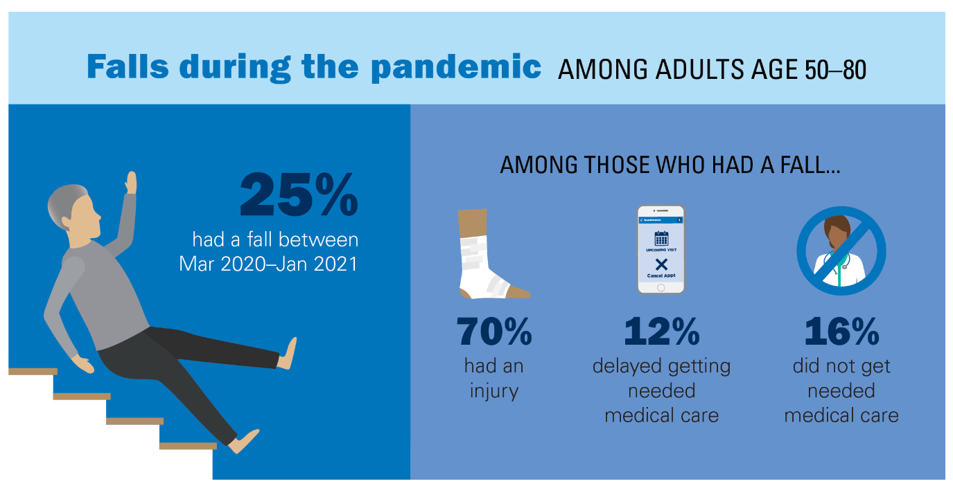

Slide 8

Problem Statement
The primary cause of both fatal and non-fatal injuries among elderly people is falls. In fact, among seniors, falls were the second most common reason for injury-related hospitalization. According to National Crime Records Bureau data, injuries caused the deaths of more than 40,000 elderly people in 2020. According to several epidemiological studies on the elderly population, 1.7% of people had injuries. In fact,among seniors, falls were the second most common reason for injury-related hospitalization. One study found that of elderly residents who had suffered a fracture due to a fall, nearly two-thirds had fallen repeatedly within the year before the fracture occurred. There are many factors that may contribute to an elderly person's risk of falling, including health issues and medication side effects, the environmental factors such as stairs or slippery floors, and social factors such as loneliness and depression. So we will be creating a device which can monitor the elderly when they are about to fall and alert those emergency contacts immediately when assistance is required.

Slide 9

Novelty
We have trained the YOLOV5 model with a large dataset. We have considered many of these conditions and trained the model in such a way we can reduce the error rate of detecting what is considered as fall and not fall.
A
B
The 3D - structure made to hold the camera module is a lightweight model and this model is a portable model.
C
We have used a esp32 camera and FTDI programmer as our hardware making the entire product cheap and feasible by customers.

Slide 10
Components Used
Software Requirements
Hardware Components
ESP 32 camera
YOLO V5S Model

Slide 11
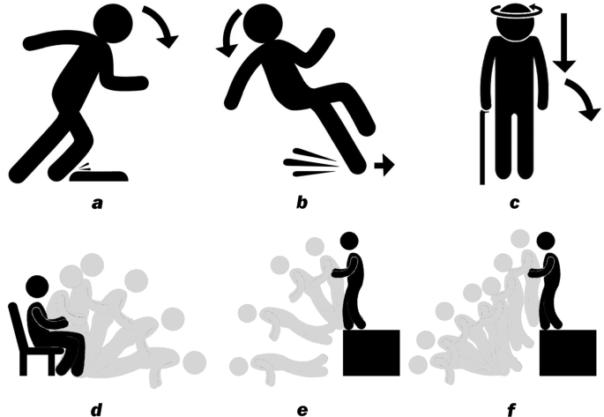
YOLO V5S Model
YOLO (You Only Look Once) is a popular object detection algorithm that aims to detect and classify objects in real-time from images and videos. YOLOv5 is the latest version of the YOLO family of models, which was introduced in 2020. YOLOv5 is based on a new architecture that uses a single convolutional neural network (CNN) to simultaneously predict bounding boxes and class probabilities for objects in an image. This new architecture is more accurate and faster than previous versions of YOLO.
We have trained the YOLO V5S model using the kaggle fall dataset . The total dataset has over 550 images. We have trained the model in such a way that our model is more accurate than previous models. We have also trained our model with a very specific custom dataset so that our model can differentiate between people kneeling down to tie their shoe-lace and actually falling down. We have considered many of these conditions and trained the model in such a way we can reduce the error rate of detecting what is considered as fall and not fall.

Slide 12
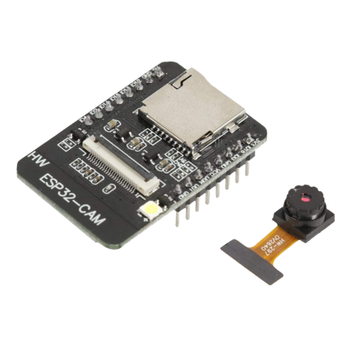
ESP32 Camera
The ESP32 Camera is a low-cost, low-power camera module based on the ESP32 chip. It integrates a high-sensitivity camera sensor, a microSD card slot, and Wi-Fi capabilities, making it an excellent choice for IoT applications that require image capture and processing.The ESP32 Camera module comes with a variety of features, such as:
High sensitivity camera sensor, Wi-Fi connectivity, MicroSD card slot, Low power consumption, Easy integration.
With its high sensitivity camera sensor and Wi-Fi capabilities, it can capture high-quality images and stream them over the internet, enabling real-time monitoring and analysis. Additionally, the microSD card slot allows for local storage of images and videos, making it ideal for applications that require offline image processing.
The general camera module and the fixing charges are costly and not feasible by everyone. Thus we have used a esp32 camera as our hardware making the entire product cheap and feasible for the customers.

Slide 13

Firebase
Firebase is a set of backend cloud computing services and application development platforms provided by Google. It hosts databases, services, authentication, and integration for a variety of applications, including Android, iOS, JavaScript, Node.js, Java, Unity, PHP, and C++.
We are using the firebases database service. Whenever the fall has been detected by our system the image at that point of time will be stored into the database. When the notification regarding the fall is sent to the user we will also be sending the URL of the image . This helps the user to identify where the fall has happened and also double check of the system has detected fall correctly.

Slide 14
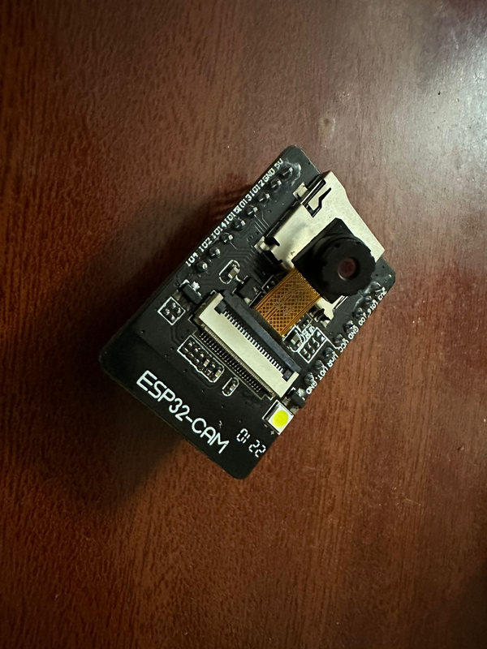
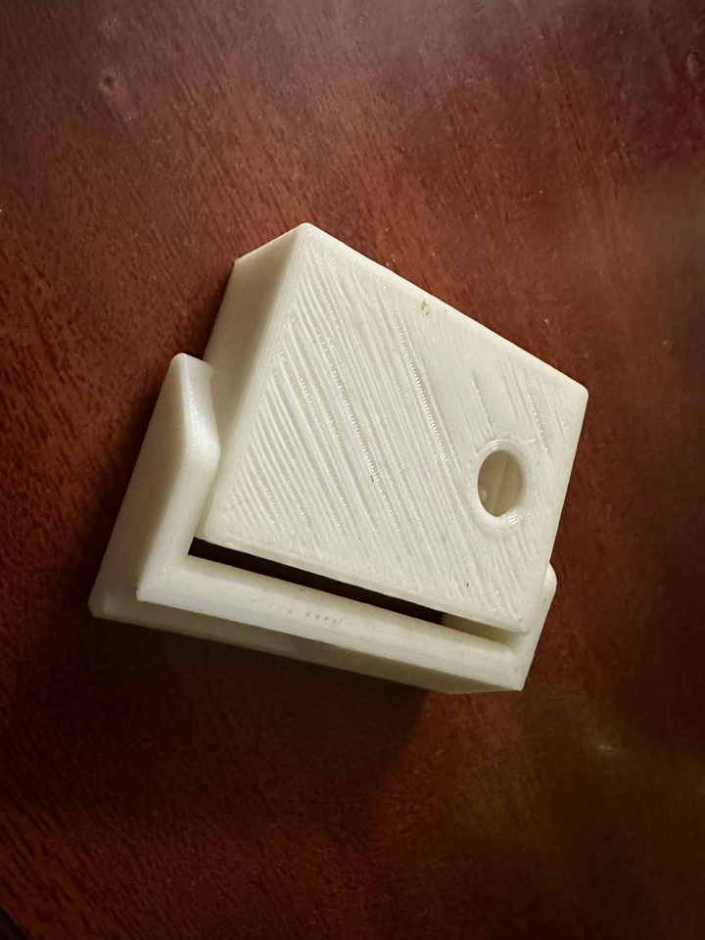
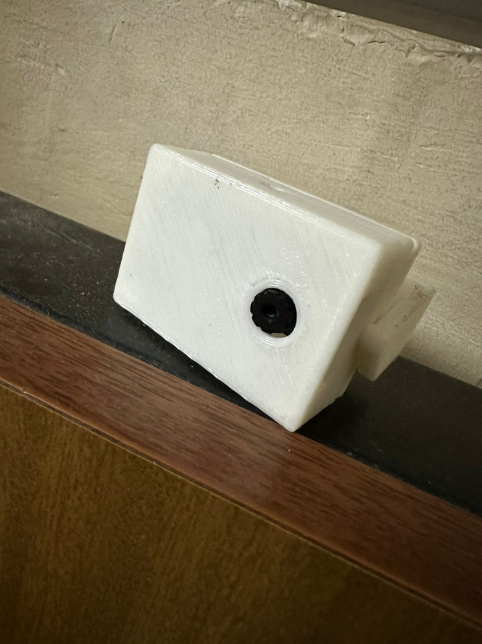
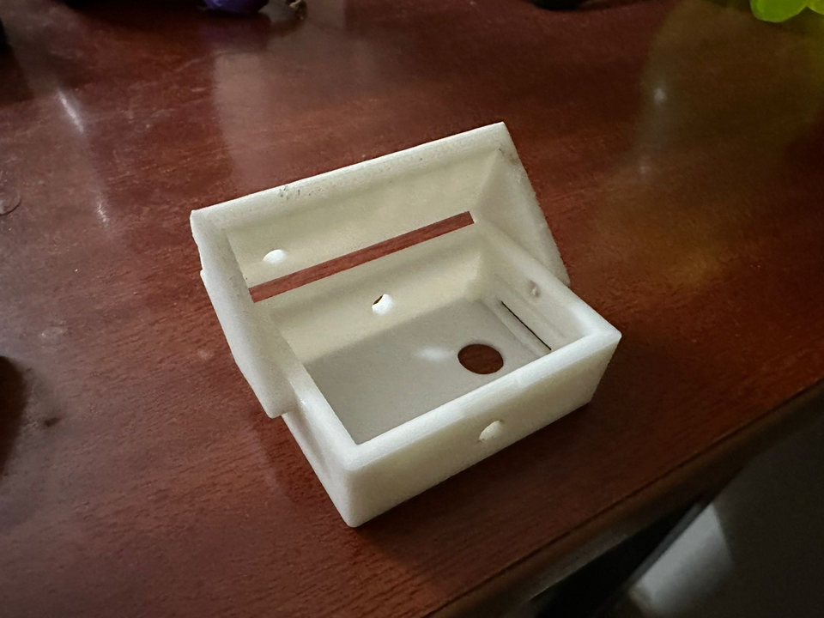
Results

Slide 15
